Slide 1
Attack In-Depth! Demonstration Day
Attack, Defense & Analysis of a Vulnerable Machine
Presented by Riley Peters

Slide 2
Table of Contents
This document contains the following resources:
Network Topology & Critical Vulnerabilities
Exploits Used
Avoiding Detection & Maintaining Access

Slide 3

Network Topology
& Critical Vulnerabilities
‹#›

Slide 4
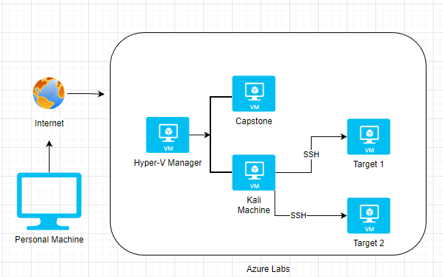
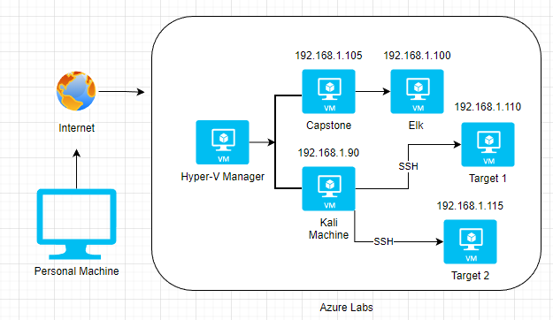
Network Topology
Network
Address Range: 192.168.1.0/24
Netmask: 255.255.255.0
Gateway: 192.168.1.1
Machines
IPv4: 192.168.1.90
OS: Debian Kali 5.4.0 GNU/Linux
Hostname: Kali
IPv4: 192.168.1.110
OS: Debian GNU/Linux
Hostname: Target 1
IPv4: 192.168.1.115
OS: Debian GNU/Linux
Hostname: Target 2
IPv4: 192.168.1.105
OS: Linux Ubuntu 18.04
Hostname: server1
(Capstone)
IPv4: 192.168.1.110
OS: Linux
Hostname: Elk
192.168.1.105
192.168.1.1
192.168.1.110
192.168.1.90
192.168.1.115

Slide 5
Critical Vulnerabilities & Weaknesses: Target 1
Our assessment uncovered the following critical vulnerabilities in Target 1.
Vulnerability | Description
WPscan Enumeration | Wordpress is unconfigured/plugin not added to block wpscan.
SSH Login using Weak Passwords CWE-521 | SSH Login possible using weak passwords.
Plaintext Password Storage CWE-256 | MySQL root password stored in plaintext
Weak Password Hashing CWE-916 | Passwords are hashed with insufficient computational effort.

Slide 6
Exploits Used
‹#›

Slide 7
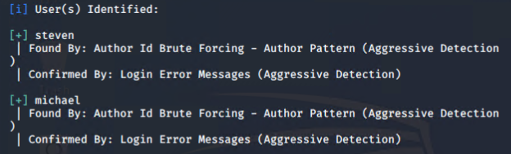
Exploitation: WPscan Enumeration
WPscan tool can perform a number of enumeration tasks on vulnerable Wordpress servers, including finding users for the server. This was done with the command:
wpscan --url http://192.168.1.110 --enumerate u
This resulted in the user names of two users being revealed (see fig.1)
fig.1 - Users enumerated from the target with wpscan.

Slide 8
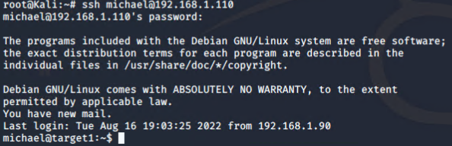
Exploitation: SSH Login using weak passwords
Brute Force attack tool was used to crack the password for the user account of Michael (see fig.2): hydra -l michael -P /usr/share/wordlists/rockyou.txt -vV ssh://192.168.1.110
Only originally possible through the use of weak SSH passwords to grant login access rather than the use of keys.
fig.2 - User Michael had set his username as his password - poor practice
CWE-521
fig.3 - SSH Access through user Michael

Slide 9
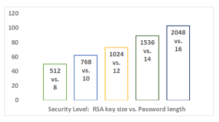
Exploitation: SSH Login using weak passwords
Using SSH keys would eliminate the risk of a weak password being brute forced as there is no password to crack. Key encryption and authentication is a much more secure way of using SSH.
source: https://thorntech.com/passwords-vs-ssh/
CWE-521

Slide 10
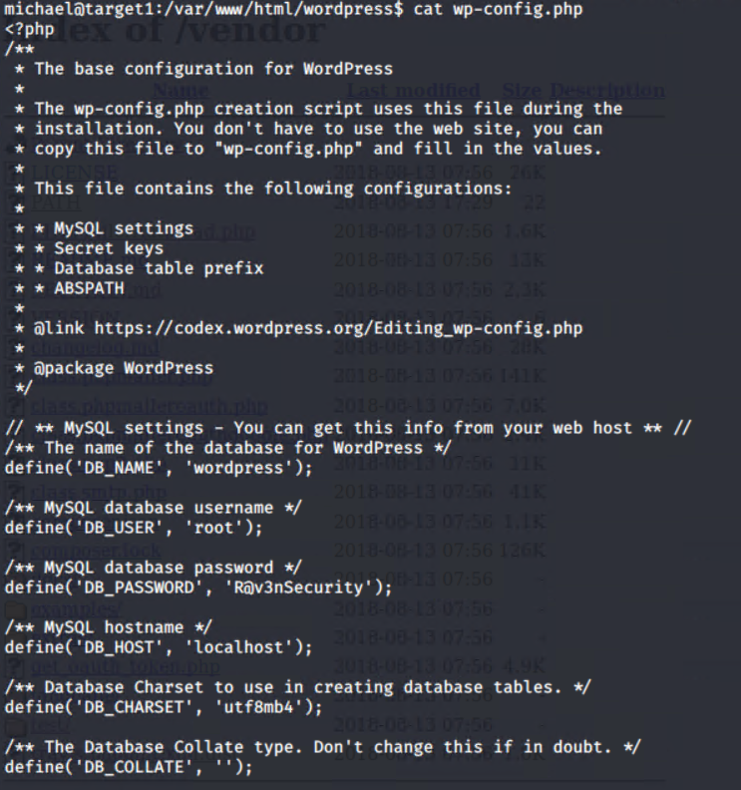
Exploitation: Plaintext Password Storage
After accessing the path /var/www/html, a directory called Wordpress was found.
The file wp-config.php could be accessed. Inside was the plaintext name and login information for the applications MySQL databases (fig.4).
fig.4 - the contents of wp-config.php. The password found was R@v3nSecurity for the root user in the database ‘Wordpress’
CWE-256

Slide 11
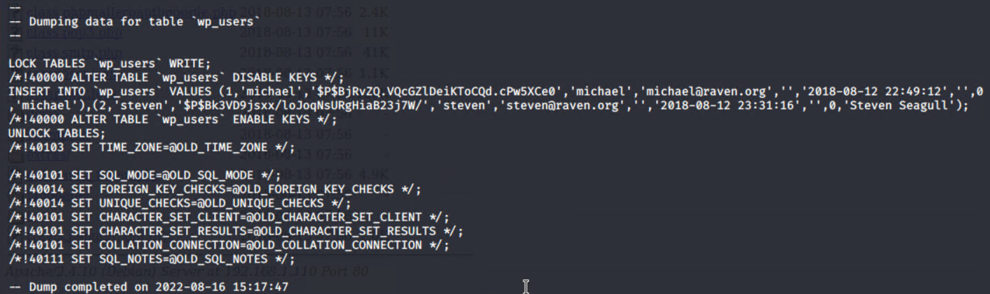
Exploitation: Plaintext Password Storage
mysqldump command used for exfiltration of database tables:
The table named ‘wp_users’ was dumped, containing all of the username and password hash information for each user on the system (fig.5).
fig.5 - ‘wp_users’ table contained the password hash data related to both michael and steven’s user accounts
CWE-256

Slide 12
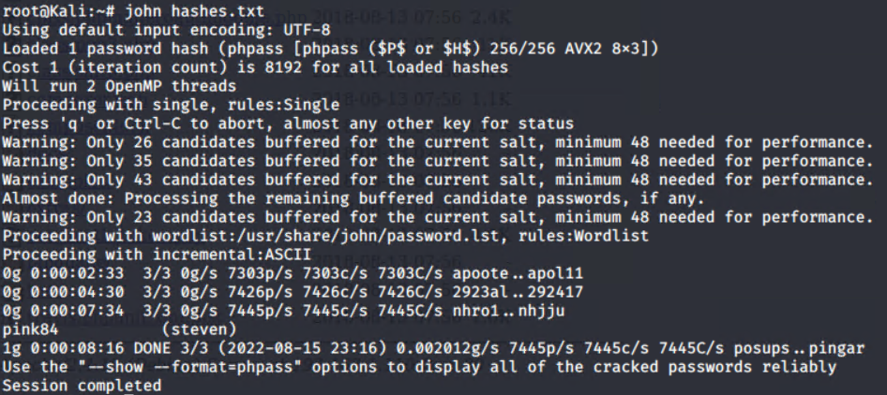
Exploitation: Weak Password Hashing
The hash was able to be cracked with a tool known as John the Ripper (see fig.6) after the values were copied over to a file called hashes.txt.
fig.6 - The John tool cracking the password hash file, resulting in the password for stevens account: pink84
CWE-916

Slide 13
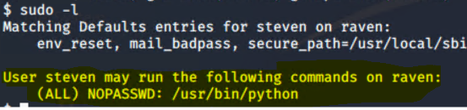
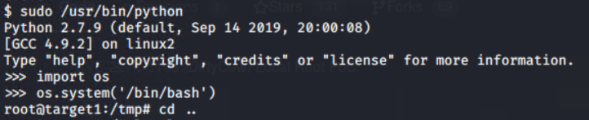
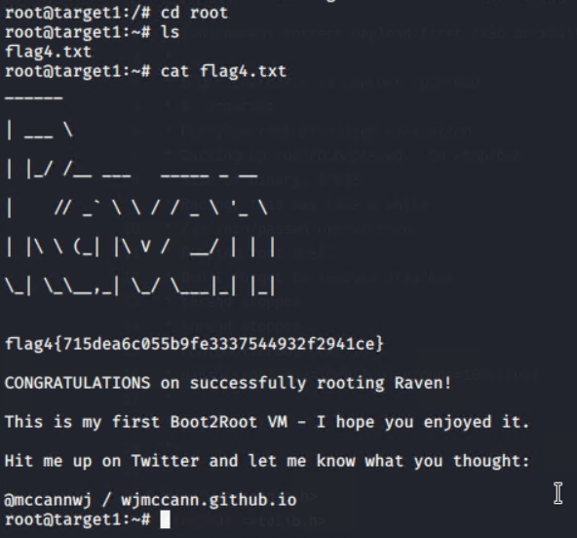
Exploitation: Weak Password Hashing
fig.7 - Once logged in as steven, the command sudo -l revealed his permission to use the Python library (highlighted).
fig.8 - Python exploit to gain a root shell. Attacker was located in the /tmp folder. From here, sensitive data in the root directory above could be accessed.
fig.9 - Sensitive data discovered - flag4.txt containing the following flag: {715dea6c055b9fe3337544932f2941ce}
CWE-916

Slide 14
Avoiding Detection
‹#›

Slide 15
Stealth Exploitation of WPscan Enumeration
Monitoring Overview
Kibana query/alert for detection:
query: user_agent.original : *WPscan* AND destination.ip: 192.168.1.110
Metrics measured:
user_agent.original and destination.ip
A threshold of one is acceptable as any traffic detected from this user agent should be blocked straight away and trigger the alarm. The trigger should enable an email and onscreen alert, along with logging of the incident.
Mitigating Detection
The WPscan options --random-user-agent or --stealthy can be used
WPscan example command:
wpscan --url 192.168.1.110 --random-user-agent --enumerate u

Slide 16
Stealth Exploitation of SSH Login using weak passwords
Monitoring Overview
Kibana query/alert for detection:
query: destination.ip : 192.168.1.110 AND destination.port : 22 AND source.ip : *
Metrics measured:
destination.ip and destination.port and source.ip
A threshold of 20 over an interval of 5 seconds is appropriate to detect SSH brute force attempts from most brute force tools. Once detected, the traffic is blocked. The alert should trigger both an onscreen alarm and an email alert, along with detailed logging of the incident.
Mitigating Detection
Hydra command that will allow user to brute force undetected by setting task number and time to wait between tasks:
hydra -t<number of tasks> -W<ttw between tasks> -l<username> -P<path to wordlist> ssh://192.168.1.110 -vV

Slide 17
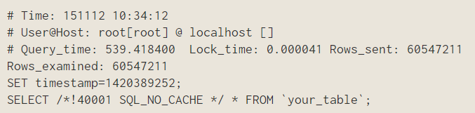
Stealth Exploitation of SQL Dump
Monitoring Overview
Kibana features support for slow log aggregation, which in turn would be used to set up alerts based on live traffic.
Slow log evidence of a MySQL dump would appear like this:
Mitigating Detection
Simply use the copy and paste option to exfiltrate data from database tables, after outputting their contents to the command line.
Eliminates the need to use a dump to retrieve data and risk alerting SOC members.

Slide 18
Maintaining Access
‹#›

Slide 19
Maintaining Access
Forms of persistence gained on the Target machines:
SSH Key Drop (on Target 1)
Service Account Creation (on Target 1)
Reverse Shell via payload (on Target 2)

Slide 20
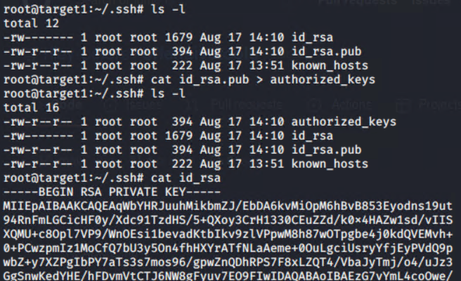
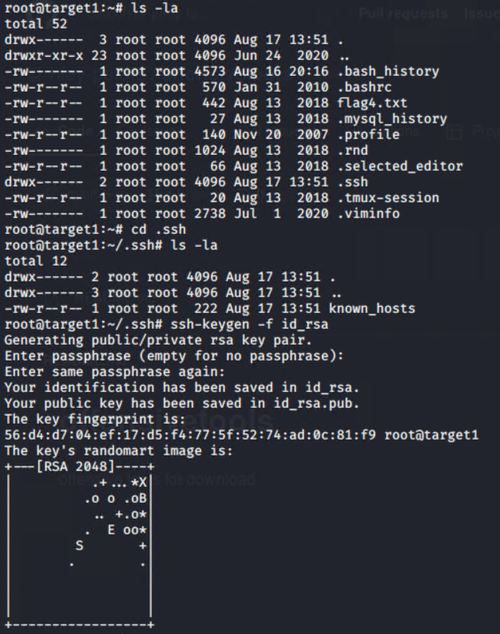
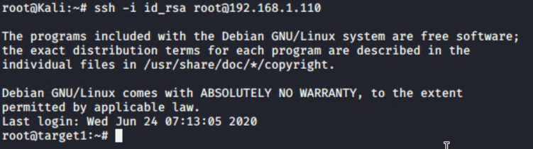
Maintaining Access: SSH Key Drop
fig.2 - Adding root user public key to the authorized_keys file, then printing the contents of the root user private key to copy to clipboard. This copy was then remade into a key file on the host machine.
fig.3 - Using the new private key created on the host machine, SSH persistence is now in effect. Ensures accessibility to the root user at any time through the attacking machine.
fig.1 - Generating SSH key pair inside root user’s /.ssh folder.

